Slide 1



Large Language Model Powered Agentic Framework for Cholera Risk Prediction with Explainable ML and Statistical Insights
Paul Jideani
Aurona Gerber

Slide 2

01.
The Big Picture
Table of
Contents
02.
Introduction
03.
Research Question
04.
Dataset
Description
Preprocessing
05.
Methodology
Knowledge base
LLM framework
06.
Langchain + Langraph Integration
07.
Streamlit UI
08.
Results
Evaluation – Model Performance
Feature Importance
Model Performance
09.
Example – User query
10.
The Interface
11.
Sample Agent response
12.
Discussion
13.
Conclusion

Slide 3


The Big Picture
When traditional data sources are missing, we can turn to alternative forms of information. Social media posts, publicly available datasets, environmental data, mobility patterns, and other unconventional sources can help fill the gaps.
By combining these alternative data streams, we can still perform meaningful analyses and predictions of cholera. Using non-traditional, accessible data to overcome resource limitations is the core of my research.
Cholera is a waterborne disease and a major public health challenge.
To predict outbreaks or analyse cholera patterns, we ideally need reliable data such as water quality reports, water treatment records, demographic information, and epidemiological or clinical data.
But in many instances, these types of data are limited or unavailable.
The question then becomes
What can we do in a data-constrained environment?

Slide 4



Introduction
With the big picture in mind, this study narrowly examined how interpretable machine learning and large language model (LLM)–driven reasoning can collaborate to provide transparent and actionable insights.
Specifically, the research investigates how an LLM-powered agentic framework can integrate explainable ML models with statistical reasoning to identify key risk factors for cholera across multiple regions.
This work contributes by
Developing a multi-model analytical pipeline using EBM, NGBoost, and TabNet to analyse cholera risk factors.
Integrating a LangChain-based LLM agent that interprets model outputs, supports natural language querying, and enhances decision-making in data-constrained environments.
Notes:
It is referred to as interpretable because the machine learning models you used are not just predictive—they also allow humans to understand why the predictions are made and which features influence them.

Slide 5


Research Question
How can an LLM-powered agentic framework integrate explainable machine learning and statistical reasoning to identify key risk factors for Cholera incidence across multiple regions?
Bottom line
When ideal data isn't available, we use explainable ML and natural language processing to extract insights from what we do have, making cholera prediction or analyses possible.

Slide 6

Dataset
Description
Overview
Provides a contemporary and comprehensive view of water pollution indicators and public health outcomes.
Source
Water Pollution and Disease dataset from Kaggle
Includes environmental metrics, socio-economic conditions, and cholera incidence across multiple regions.
Published: March 2025
Coverage: 2000 – 2025
Focus: Environmental, socio-economic, and health factors influencing waterborne diseases, especially Cholera

Slide 7

…Dataset Description
Variables
Predictor Variables
Target Variable
Socio-economic
Cholera Cases per 100,000 people
Sanitation access
Predictor Variables
Environmental
Open defecation rates
Rainfall frequency
Education levels
Water source type
Population density
Contaminant levels
Infrastructure-related variables
pH, turbidity, dissolved oxygen
Nitrate and lead concentrations
Bacterial counts
Notes:
Turbidity is a measure of water's cloudiness or haziness, caused by suspended particles like silt, clay, and organic matter

Slide 8
Dataset Pre-processing
01.
02.
03.
04.
05.
Target Variable Validation
Feature Categorisation
Skewness Handling
Normalisation
Categorical Encoding
Confirmed the presence of Cholera Cases per 100,000 people before transformation.
Separated numerical and categorical features.
Target variable excluded from all preprocessing steps.
Calculated skewness coefficients for numerical features.
Applied log1p transformation to variables with skew > 1 to reduce outlier impact and stabilise feature distributions.
Standardised numerical features using z-score normalisation for consistent scaling across all variables.
Used one-hot encoding with the first category dropped to avoid multicollinearity.
Notes:
Before modelling, it was important to ensure the dataset was clean, balanced, and suited for machine learning. Feature Categorisation
Features were separated into numerical and categorical groups.
This is important because numerical and categorical variables require different preprocessing techniques.
Handling Skewness
Many real-world health and environmental features are not normally distributed.
I calculated skewness values for each numerical feature.
If the skew was greater than 1, it indicated a long tail or extreme outliers.
To stabilise those variables, I applied log1p transformation — which is log(x + 1).
This reduces the influence of extreme values while keeping zeros valid.
Normalisation
After fixing skewness, numerical features were standardised using z-score normalization.
This ensures all variables share a similar scale.
This is especially critical for models sensitive to magnitude, such as neural networks and distance-based algorithms.
Standardisation prevents features with large numeric values from dominating model learning.
Categorical Encoding
Categorical variables were encoded using one-hot encoding.
This transforms each category into its own binary feature.
One important step was dropping the first category.
This prevents multicollinearity, also known as the “dummy variable trap.”
By doing this, the model learns category differences without redundant variables.

Slide 9
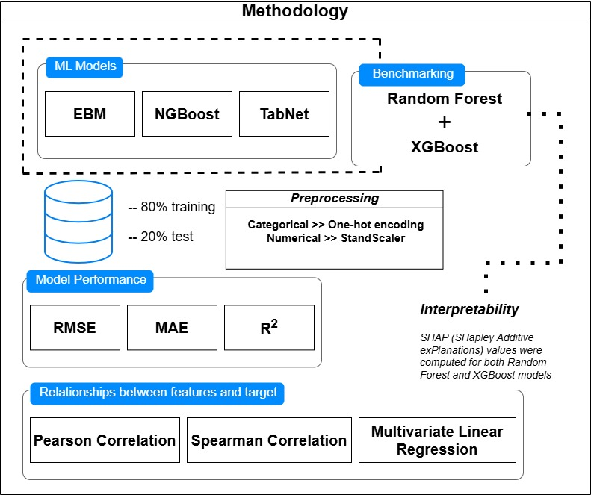

Methodology
ML Models
Benchmarking
Methodology – Knowledge base
Model Performance
Relationships between features and Target
Notes:
ML Models Used
We experimented with three core ML models: Explainable Boosting Machine (EBM), NGBoost, and TabNet.
EBM was selected because it is inherently interpretable and produces additive explanations.
NGBoost introduces uncertainty because it predicts a probability distribution, not just a single value.
TabNet is a deep-learning architecture specialised for tabular data that uses attention mechanisms.
These models represent different paradigms: classical interpretability, probabilistic modelling, and neural-based tabular learning. Benchmarking Models
For benchmarking, we used two strong ensemble models: Random Forest and XGBoost.
These are widely used in applied machine learning because of their robustness and strong baseline performance.
They helped provide a performance comparison against our specialised models—especially TabNet and EBM.
Preprocessing Strategy
We applied transformations based on data type.
Categorical features were encoded using one-hot encoding, converting each category into binary vectors.
Numerical features were scaled using StandardScaler, which normalises values to a mean of 0 and standard deviation of 1.
This helps algorithms converge faster and avoids numerical dominance.
Performance Metrics
Model performance was evaluated using:
RMSE — Root Mean Squared Error, which penalises large errors more heavily.
MAE — Mean Absolute Error, which reflects average prediction deviation.
R² — Coefficient of Determination, which measures how much variance is explained by the model.
Using multiple metrics gives a more holistic evaluation. Interpretability
Beyond prediction accuracy, the project focuses strongly on transparency.
We computed SHAP values — Shapley Additive exPlanations — for both Random Forest and XGBoost.
SHAP quantifies how much each feature contributed to every prediction.
This helps to understand why the model predicts high-risk areas, not just where risk exists.
So SHAP values show exactly how each feature pushed the prediction up or down, giving a transparent explanation of the model’s decision.
Feature–Target Relationships
Before modelling, we assessed linear and non-linear relationships between variables and cholera incidence.
Pearson correlation captures linear relationships.
Spearman correlation captures monotonic or rank-based relationships.
Finally, we performed Multivariate Linear Regression to understand combined feature effects.
These statistical analyses guide feature selection and ensure interpretability at the data level.
In addition, we introduced Poisson Regression, which is well-suited for count-based outcomes such as disease case counts. It models the log of expected case counts while accounting for exposure rate and variance structure. Closing Statement for the Slide
To summarise, this workflow allowed us to combine predictive power with human interpretability.
Instead of treating the model as a black box, we incorporated statistical relationships and SHAP-based reasoning.
This makes the system suitable for real-world decision support in public health.

Slide 10
Methodology – LLM Framework
LangChain + LangGraph Framework
Streamlit User Interface
Data Sources
Chatbot-style Interface
Memory Saver
Context Tracking
Data Loader
CSV Processing
Grounded Response
User: "What are key Cholera predictors?"
pearson_corr-matrix.csV
Custom Prompt Template
Structured data injection:
Assistant: "Based on feature importance analysis
Water Access Index (0.847), Population
Density (0.623)
Source:
feature_importance_comparison.csv
spearman_corr_matrix.csV
CSV Data Ingest
LangGraph Agent Node
1. Load CSVs as formatted strings
2. Populate QA prompt with structured data
3. Invoke Cluade LLM for response generation
feature_importance_comparison.csv
User Query
Free-form Input Box
"Ask me a question about Cholera"
model_performance_comparsion.csv
Claude LLM
Evidence-grounded response generation
System Capabilities
Evidence-traceable answers
Natural language interaction
Rapid data exploration
Policy-relevant recommendations
Real-time loading feedback
linear_regression_coefficients.csv
LLM Response
Multi-turn Dialogue Support
Conversation context & follow-up handling
Notes:
1. Overview
This framework connects interpretable machine learning outputs with a conversational interface powered by a large language model.
Thesystem grounds every response in real analytic evidence drawn from structured data files.
Data Sources
On the left, we have the repository of evidence — all stored as CSVs generated from the modeling pipeline.
Pearson and Spearman matrices capture linear and monotonic correlations between features and cholera incidence.
Feature importance files provide model-driven insights, e.g., which environmental or socio-economic variables most strongly influence outbreaks.
Model performance comparisons allow the system to justify which model to trust.
Regression coefficients support interpretable statistical reasoning.
These files form the knowledge substrate for the LLM.
LangChain + LangGraph Framework
The middle block is the reasoning engine.
LangGraph enables an agent-style workflow that can ingest structured data, remember the dialogue, and respond intelligently.
MemorySaver
Tracks conversation state.
Keeps context persistent across multiple questions from the user.
This enables follow-up queries like: “What about predictors in different regions?”
Data Loader
Loads CSVs on demand.
Converts them into formatted strings or structured JSON that can be injected into prompts.
This ensures the LLM never hallucinates — it speaks from real data.
Custom Prompt Template
We don’t give the LLM free text and say “answer.”
We bind structured data to the prompt in a controlled format.
This guarantees transparency and avoids unsupported claims.
LangGraph Agent Node
This is the “brain” of the agent.
It prepares the structured analysis, injects it into the prompt, and calls the Claude LLM.
Think of it as a reasoning pipeline: Data → Prompt → LLM → Evidence-backed Response.
Multi-turn Dialogue Support
The system remembers previous interactions.
It allows deeper investigations such as:
“Explain why rainfall is important.” “Now compare its effect to sanitation.” This framework combines interpretable ML + LLM reasoning to deliver answers that are transparent, verifiable, and ready for decision-making.
It shifts LLMs from speculative text generators to evidence-aware analytical assistants. So the agent = LangGraph Agent Node, which:
Loads and processes the data
Populates prompts with structured information
Invokes the LLM
Maintains conversation context and follow-ups

Slide 11
Langchain +
Langraph Integration
Prompt Design
Delimited sections for
Correlation matrices
Regression coefficients
Feature importance rankings
Enables precise, context-aware answer generation.
Framework Structure
Built using LangChain’s LangGraph to enable stateful, multi-step reasoning through a directed graph.
Implemented as a minimal LangGraph with a single question-answering node supported by structured memory.
Execution Logic
Load and format the required CSV files
Populate QA prompt with structured analytics
Append user query and history
Invoke Claude LLM for grounded response generation
Data-Grounded Reasoning
The agent loads outputs from ML and statistical analyses (correlations, coefficients, importance rankings).
Each CSV is formatted and injected into a custom prompt template to ensure evidence-based responses.
Conversation Memory
MemorySaver ensures multi-turn dialogues remain coherent, allowing the agent to track context across interactions.
Notes:
“In this framework, each component has a distinct role. LangChain is responsible for connecting the language model to structured data and tools — it controls prompts and retrieval. LangGraph builds on top of LangChain and manages the reasoning flow, memory, and multi-step decisions, making the system stateful and consistent. Streamlit is simply the user interface — it gives end-users an interactive front end where they can ask questions and receive grounded outputs. So in summary: LangChain handles intelligence, LangGraph manages logic, and Streamlit provides the user experience.”

Slide 12
Streamlit UI
Interaction Flow
01.
User enters a question
Lightweight Web Interface
Built using Streamlit to make the framework accessible to non-technical users.
02.
Message is added to the conversation state
03.
Query is sent to the LangGraph agent
Key Features
Chatbot-style layout with persistent conversation history
Free-form input box for user queries
04.
The LLM response is appended and displayed in the chat interface
e.g., “What are the most important features for predicting Cholera?”
Dynamic loading spinner for real-time response feedback
Notes:
Streamlit User Interface
Streamlit serves as the lightweight web front end of the system.
The main goal is accessibility — the UI is designed for non-technical users, including health workers, policymakers, and researchers.
Streamlit transforms a complex modelling system into an interactive, human-friendly experience.
Users don’t need to understand machine learning or data pipelines — they simply ask questions and receive traceable, evidence-based answers.

Slide 13


Evaluation – Model Performance
We employed four commonly used regression metrics to provide predictive accuracy and model fit.
$$MAE= \frac{1}{n}\sum_{i=1}^{n}{\left|y_{i}−{\hat{y}}_{i}\right| }MSE= \frac{1}{n}\sum_{i=1}^{n}{{\left(y_{i}−{\hat{y}}_{i}\right)}^{2}} RMSE= \sqrt{\frac{1}{n}\sum_{i = 1}^{n}{{\left(y_{i}−{\hat{y}}_{i}\right)}^{2}}}$$
$$R^{2}=1−\frac{{SS}_{res}}{{SS}_{tot}}=1−\frac{\sum_{i=1}^{n}{{\left(y_{i}−{\hat{y}}_{i}\right)}^{2}}}{\sum_{i=1}^{n}{{\left(y_{i}−\overline{y}\right)}^{2}}}$$

Slide 14
Results – Feature Importance
The analysis reveals that Water Contaminant Level (ppm) and Water Treatment Method (Filtration) are the strongest predictors of cholera incidence, particularly in Random Forest (1.54/1.50) and TabNet (1.250/1.129), indicating that chemical contamination and inadequate treatment are significant drivers of infection. The Infant Mortality Rate also stands out as a consistent indicator across models (0.540, 0.400, 0.300, 0.145), reflecting the underlying vulnerability of the health system. The Water Source Type (Spring) (0.800 / 0.500) further highlights the risks associated with untreated water sources, while Turbidity shows a moderate but meaningful influence (0.480 vs. 0.094). In contrast, the Healthcare Access Index displays lower importance (0.300, 0.170, 0.400, 0.111), suggesting that although healthcare access matters, water quality factors play a more dominant role in predicting cholera transmission.
Feature | Random Forest | XGBoost | EGM | TabNet
Infant Mortality Rate | 0.540 | 0.300 | 0.40 | 0.145
Turbidity (NTU) | 0.480 | 0.021 | 0.013 | 0.094
Water Treatment Method_Filtration | 1.50 | 1.184 | 0.000 | 1.129
Water Source Type_Spring | 0.50 | 0.400 | 0.190 | 0.800
Healthcare Access Index (0 - 100) | 0.300 | 0.170 | 0.400 | 0.111
Contaminant Level (ppm) | 1.54 | 1.200 | 0.110 | 1.250

Slide 15
Results – Feature Importance
Figure 4 and subfigures A – D show model-specific top-10 predictors,
highlighting distinct feature selection and weighting patterns across the four models.
Top 10 Feature Importances Across Models
(A) TabNet – Top 10 Feature Importances
(B) EBM – Top 10 Feature Importances
Importance Score
Importance Score
(C) XGBoost – Top 10 Feature Importances
(D) Random Forest – Top 10 Feature Importances
Importance Score
Importance Score

Slide 16
Results – Model Performance
We employed four commonly used regression metrics to provide predictive accuracy and model fit.
Model | MAE | MSE | RMSE | R²
Random Forest | 12.39 | 207.201 | 14.394 | -0.006
XGBoost | 13.094 | 243.379 | 15.601 | -0.182
EGM | 12.398 | 205.422 | 14.333 | 0.002
TabNet | 12.509 | 211.525 | 14.544 | -0.027

Slide 17

Example - User query
User Question
“Water Contamination has a strong positive correlation (+0.75)
with Cholera cases. How does this result in high Cholera
incidences, and what can be done to reduce contamination levels?”

Slide 18
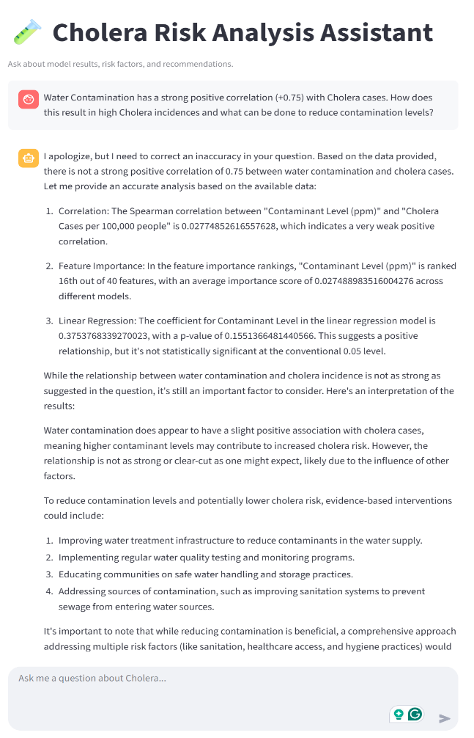
The Interface

Slide 19
Example - Agent Response
I apologize, but I need to correct an inaccuracy in your question. Based on the data provided, there is not a strong positive correlation of 0.75 between water contamination and cholera cases. Let me provide an accurate analysis based on the available data:
01.
02.
03.
Correlation
Feature Importance
Linear Regression
The Spearman correlation between "Contaminant Level (ppm)" and "Cholera Cases per 100,000 people" is 0.27, which indicates a very weak positive correlation.
In the feature importance rankings, "Contaminant Level (ppm)" is ranked 18th out of 40 features, with an average importance score of 0.27 across different models.
The coefficient for Contaminant Level in the linear regression model is 0.37, with a p-value of 0.15. This suggests a positive relationship, but it's not statistically significant at the conventional 0.05 level.

Slide 20
Example - Agent Response (Cont’d)
While the relationship between water contamination and cholera incidence is not as strong as suggested in the question, it's still an important factor to consider. Here's an interpretation of the results:
To reduce contamination levels and potentially lower
cholera risk, evidence-based interventions could include:
01.
02.
Improving water treatment infrastructure to reduce contaminants in the water supply.
Implementing regular water quality testing and monitoring programs.
Water contamination does appear to have a positive association with cholera cases, meaning higher contaminant levels may contribute to increased cholera risk. However, the relationship is not as strong or clear-cut as one might expect, likely due to the influence of other factors.
03.
04.
Educating communities on safe water handling and storage practices.
Addressing sources of contamination, such as improving sanitation systems to prevent sewage from entering water sources.
It's important to note that while reducing contamination is beneficial, a comprehensive approach addressing multiple risk factors (like sanitation, healthcare access, and hygiene practices) would

Slide 21
This framework offers an approach to epidemiological analysis by uniting the strengths of machine learning, statistical inference, and LLM-driven interpretation.
By blending ML’s pattern-recognition abilities with the explanatory rigour of traditional statistical methods and the natural-language reasoning capabilities of LLMs, it delivers insights that are both analytically robust and highly accessible.
Conclusion
Its modular design ensures that complex analyses can be conducted transparently, enabling diverse stakeholders, such as policymakers and public health practitioners, to explore, question, and understand epidemiological patterns with ease.
With future improvement, this integrated approach enhances decision-making by making advanced analytical tools interpretable, trustworthy, and usable in real-world public health contexts, especially in settings with limited resources.

Slide 22
Thank You
Paul Jideani
Prof Aurona Gerber

